Slide 1




Big Data
Gurpreet Singh
ECIS- 202112064
Woosong University
South Korea
Big Data Professor
aProfessor Preethi Ananthachari
Woosong University
Korea

Slide 2
"Unlocking Insights: Log Analysis with Hadoop"
This presentation showcases how organizations can leverage Hadoop's distributed computing framework to process and analyze large volumes of log data efficiently.

Slide 3
What I learnt while using mapreduce and hive
SENTIMENT ANALYSIS USING mapreduce AND HIVE
Large sets of matrix multiplication using mapreduce
Word counter for large set of data
Log analysis using mapreduce and hive
FRAUD Detection using mapreduce and hive

Slide 4
Personally one of the best class in this semester.
More focused on practical than theory
Enjoyed getting milestones to complete
Gain curiosity and more knowledge in using frameworks like this.
Concept focused

Slide 5

What is a log? Why it’s so important ?
In cybersecurity, a log refers to a record of activities, events, or transactions occurring within a computer system or network. Logs are crucial for cybersecurity because they provide an audit trail of actions, help detect security incidents, facilitate incident response and forensics, and aid in compliance with regulatory requirements by providing evidence of security controls and monitoring activities.

Slide 6

Many IT Professionals use Mapreduce to check for log analysis

Slide 7

How would you know that your computer/ organization is hacked ?
The people in cybersecurity uses such frameworks to take out logs and analyzes them deeply, in the field of cyber forensics many times you have seen that the systems are seized by the cyber devision.

Slide 8
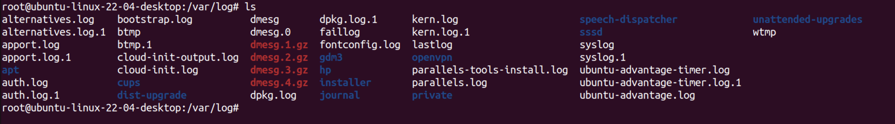
Let’s check for logs in ubuntu ! SYSTEM LOG
To check for system log that what’s happening in system you can go to
/var/log/
cat syslog

Slide 9
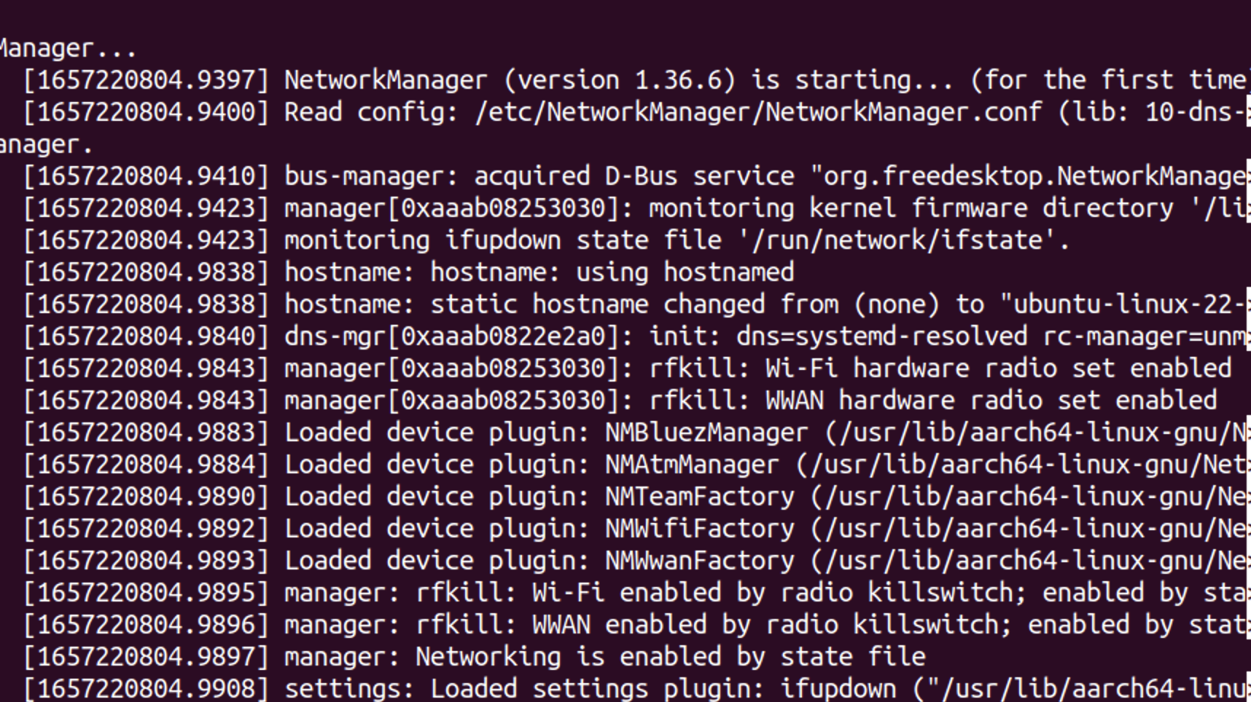
Let’s check for logs in ubuntu ! NETWORK LOG
journalctl /usr/sbin/NetworkManager

Slide 10
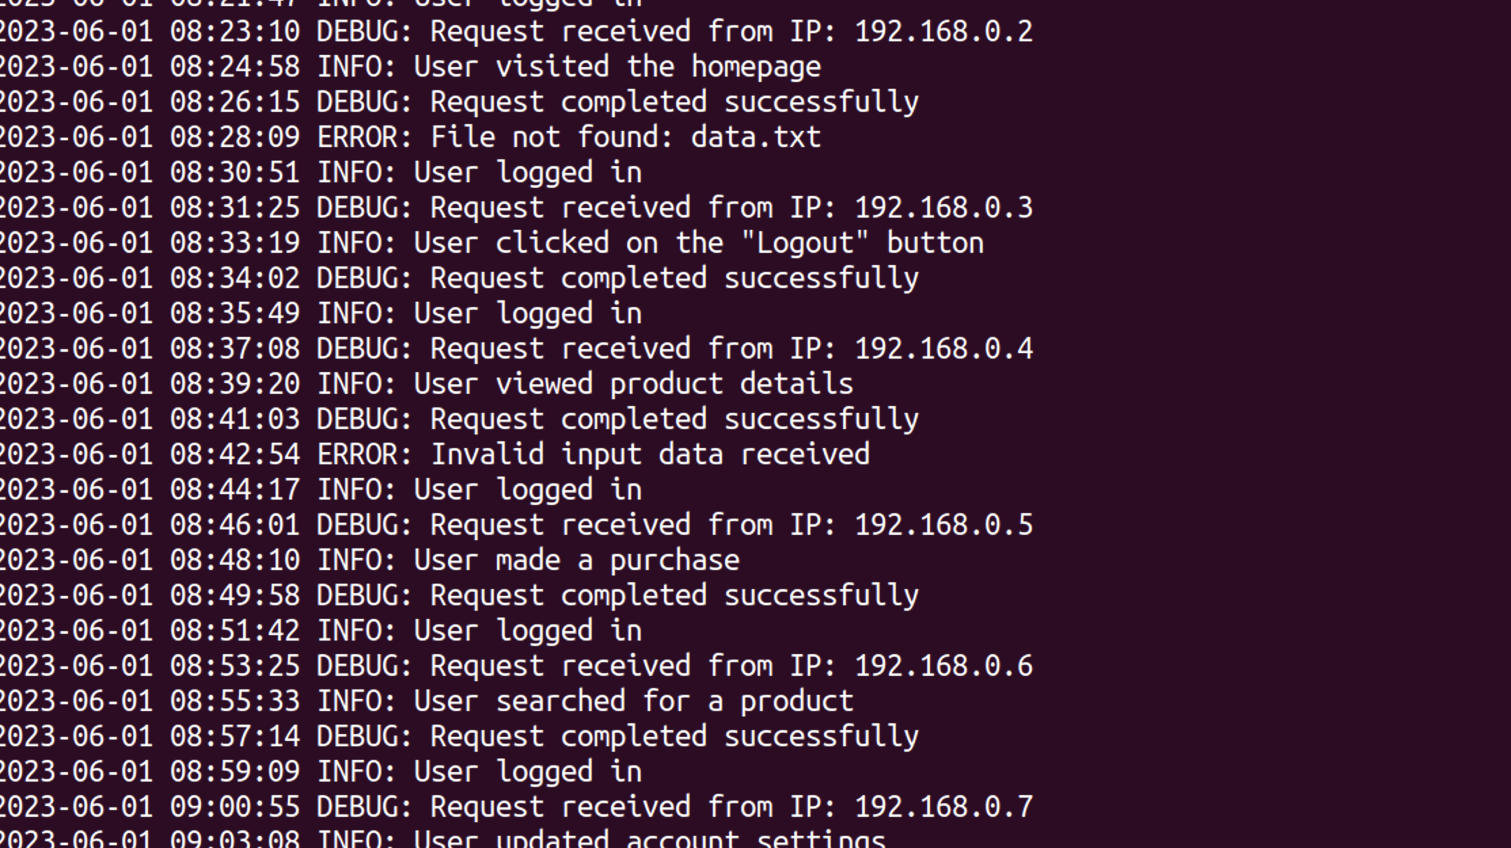
Let’s use mapreduce to analyze logs !
Copy the log from your ubuntu system and create a text file.

Slide 11
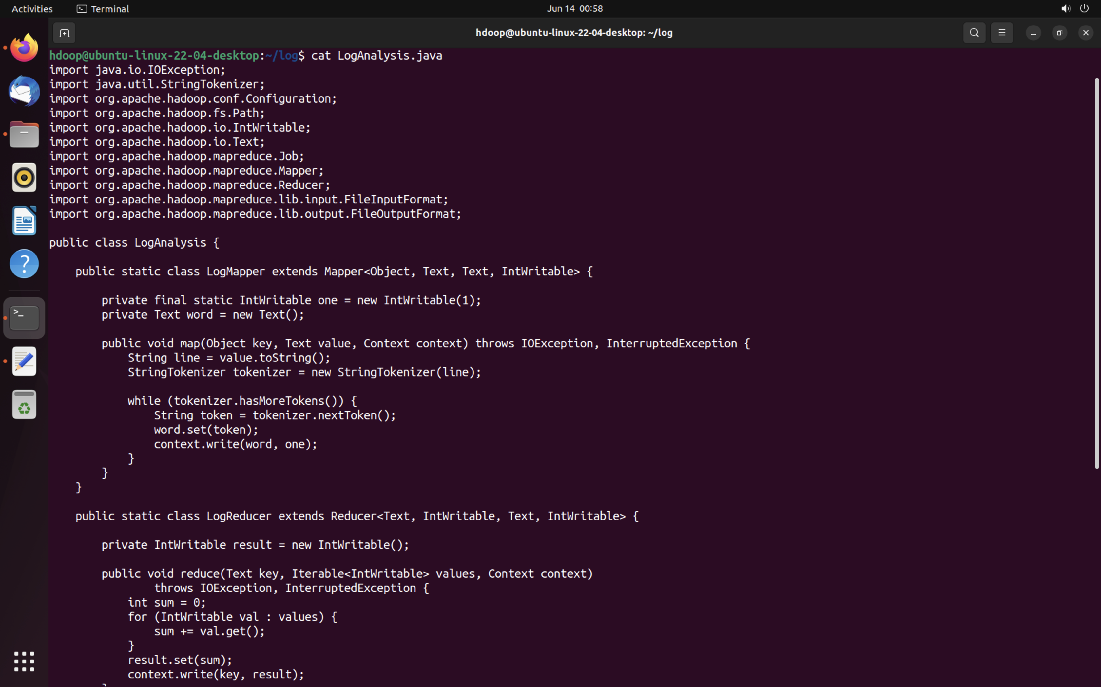
Let’s create java file according to log analysis

Slide 12
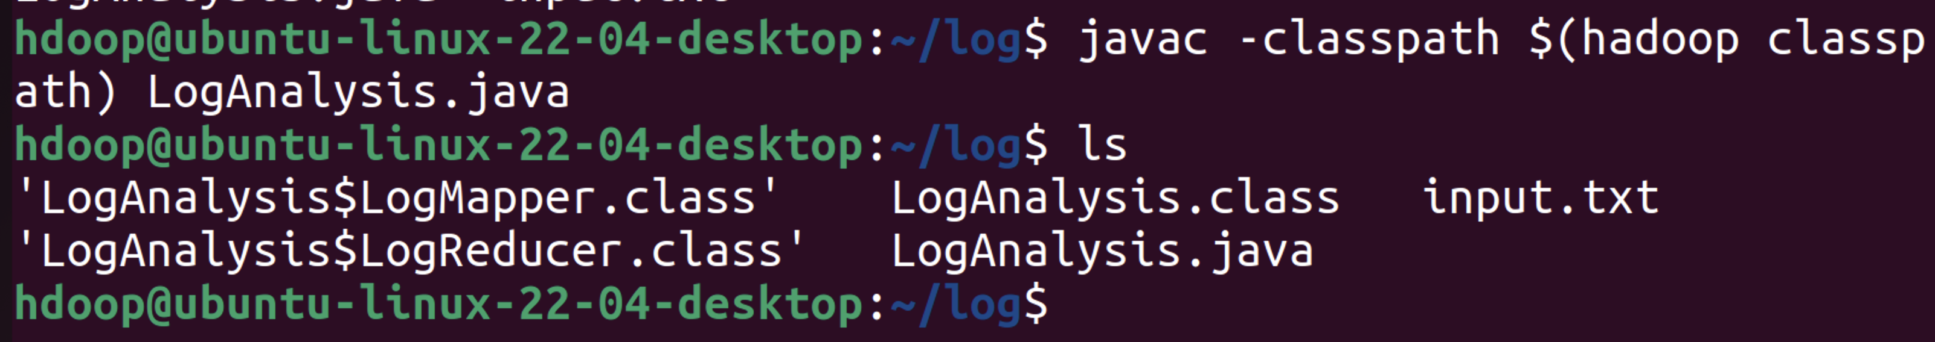
Let’s declare the classpath !

Slide 13
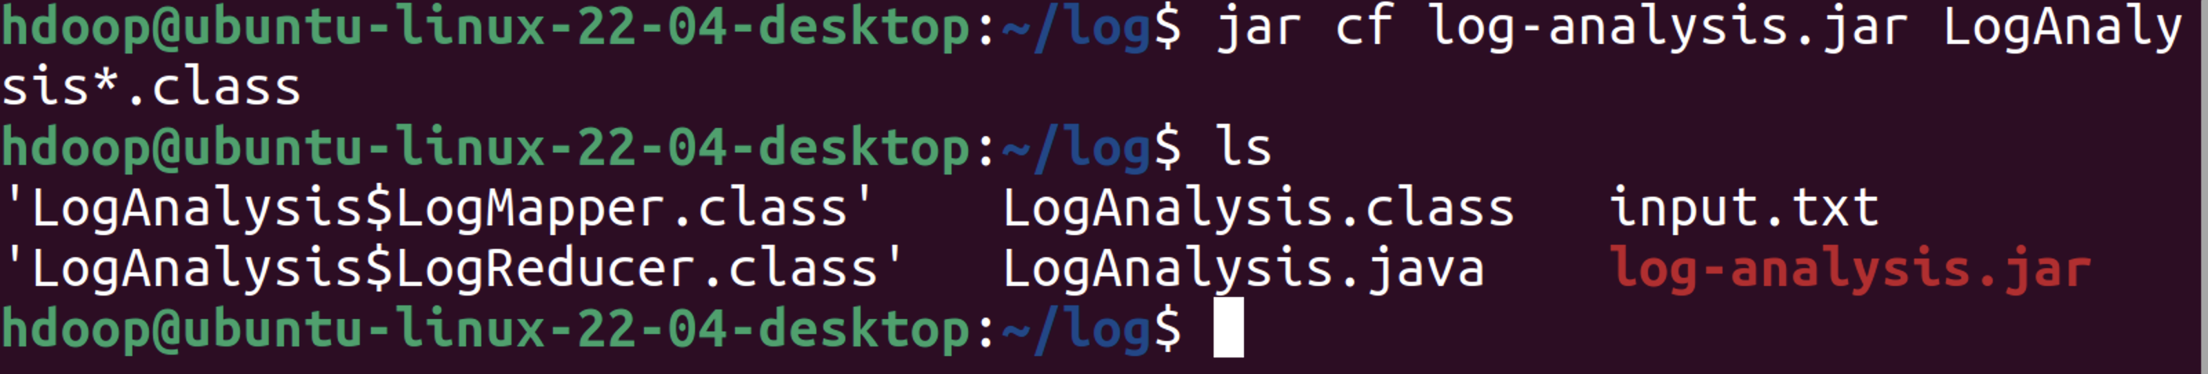
Let’s create JAR file !

Slide 14
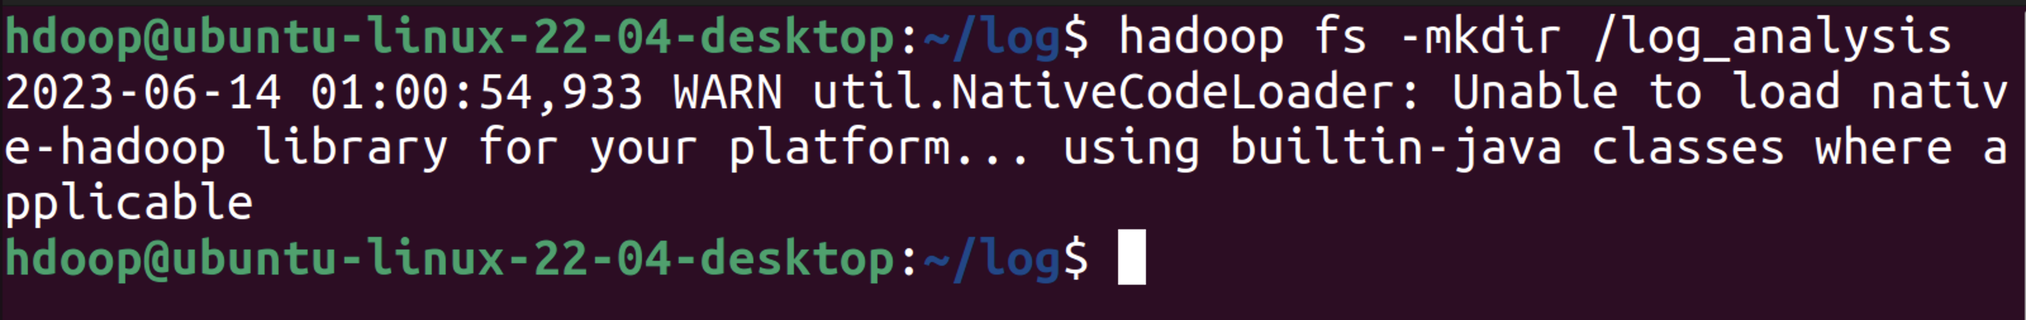
Start all nodes and make log_analysis on hdfs

Slide 15
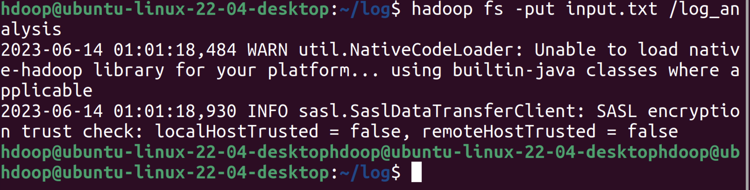
Put/upload the input.txt on log_analysis

Slide 16
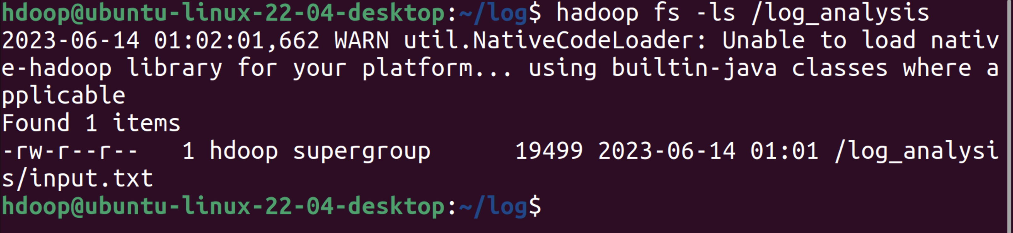
List the file on log_analysis folder

Slide 17
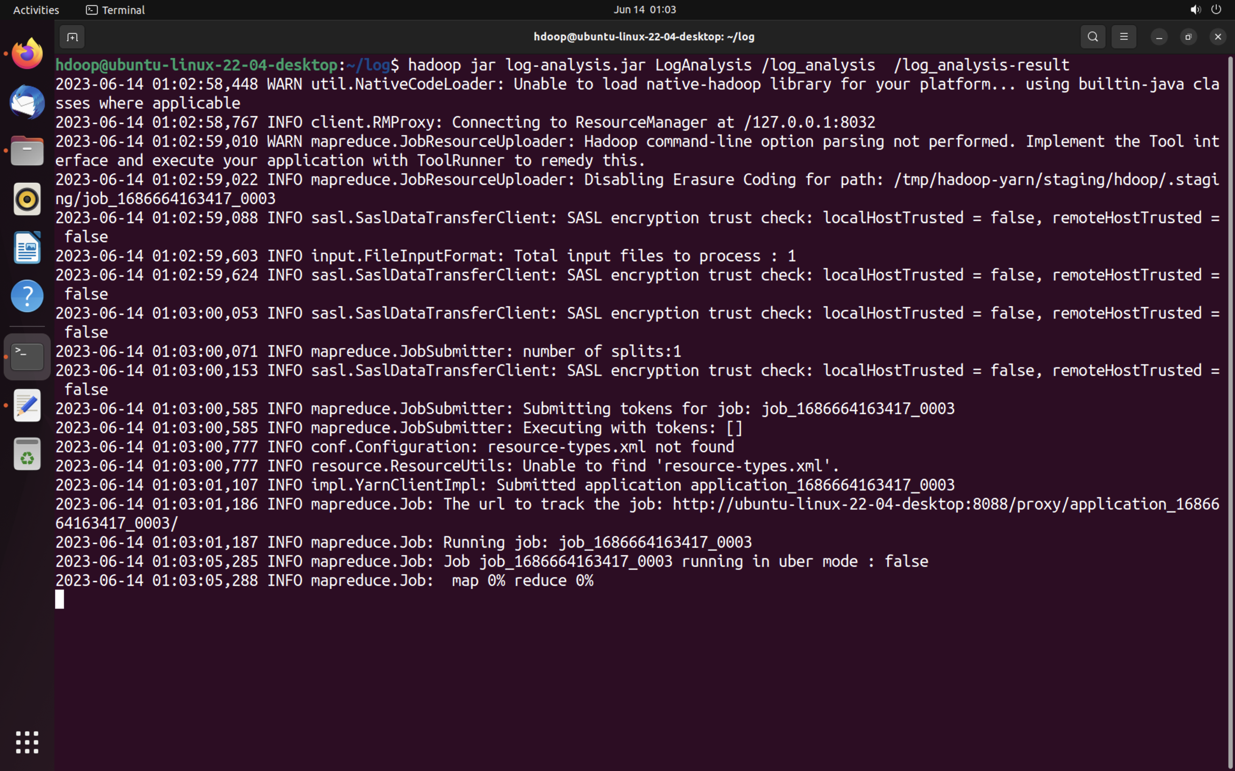
Let’s execute the file and save it on log_analysis-result

Slide 18
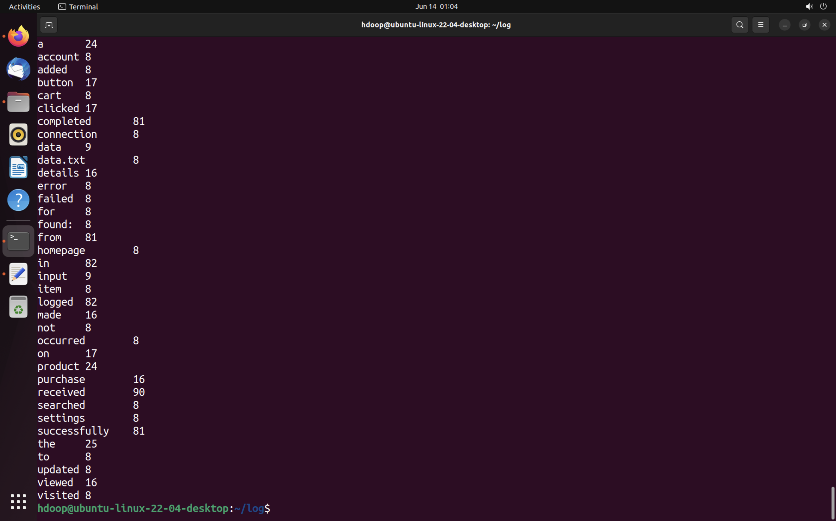
It’s done

Slide 19
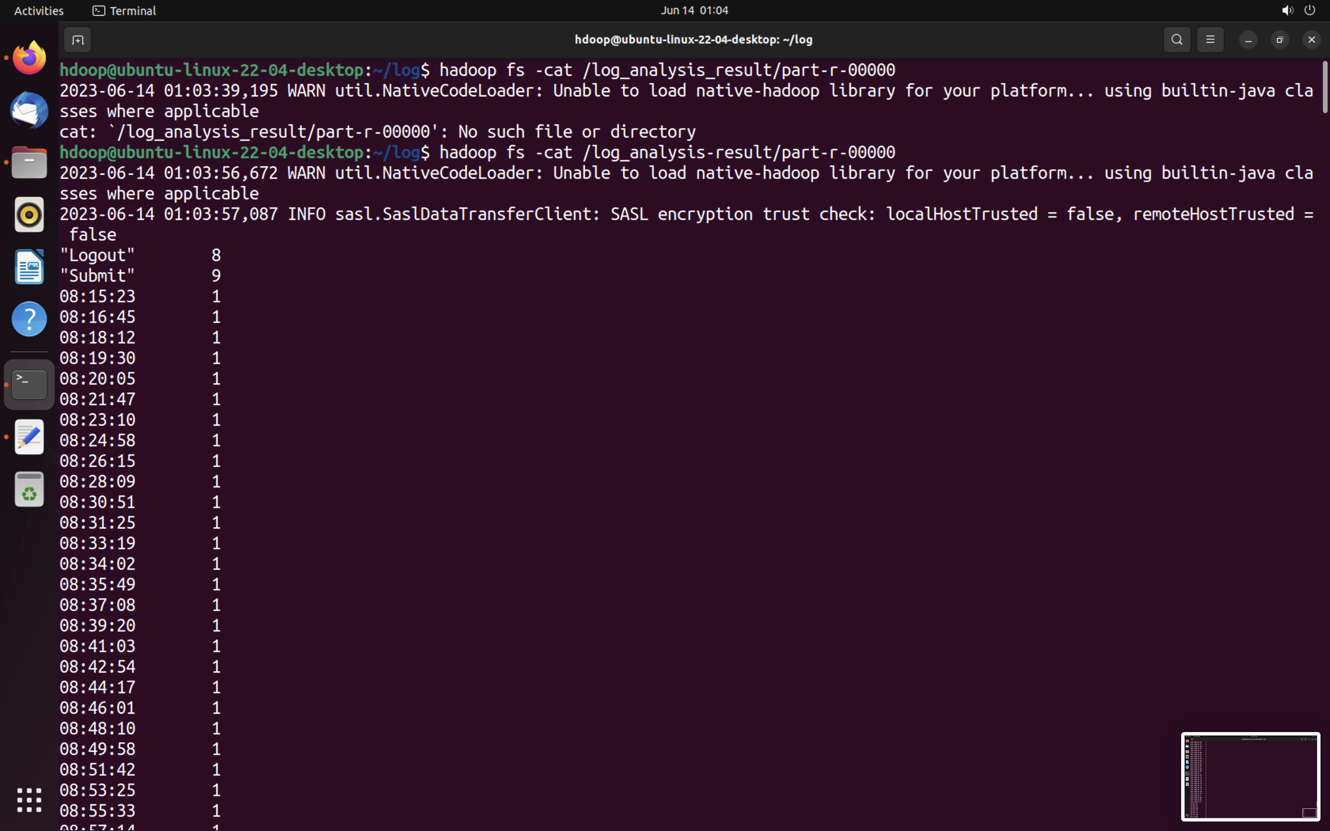
Result

Slide 20
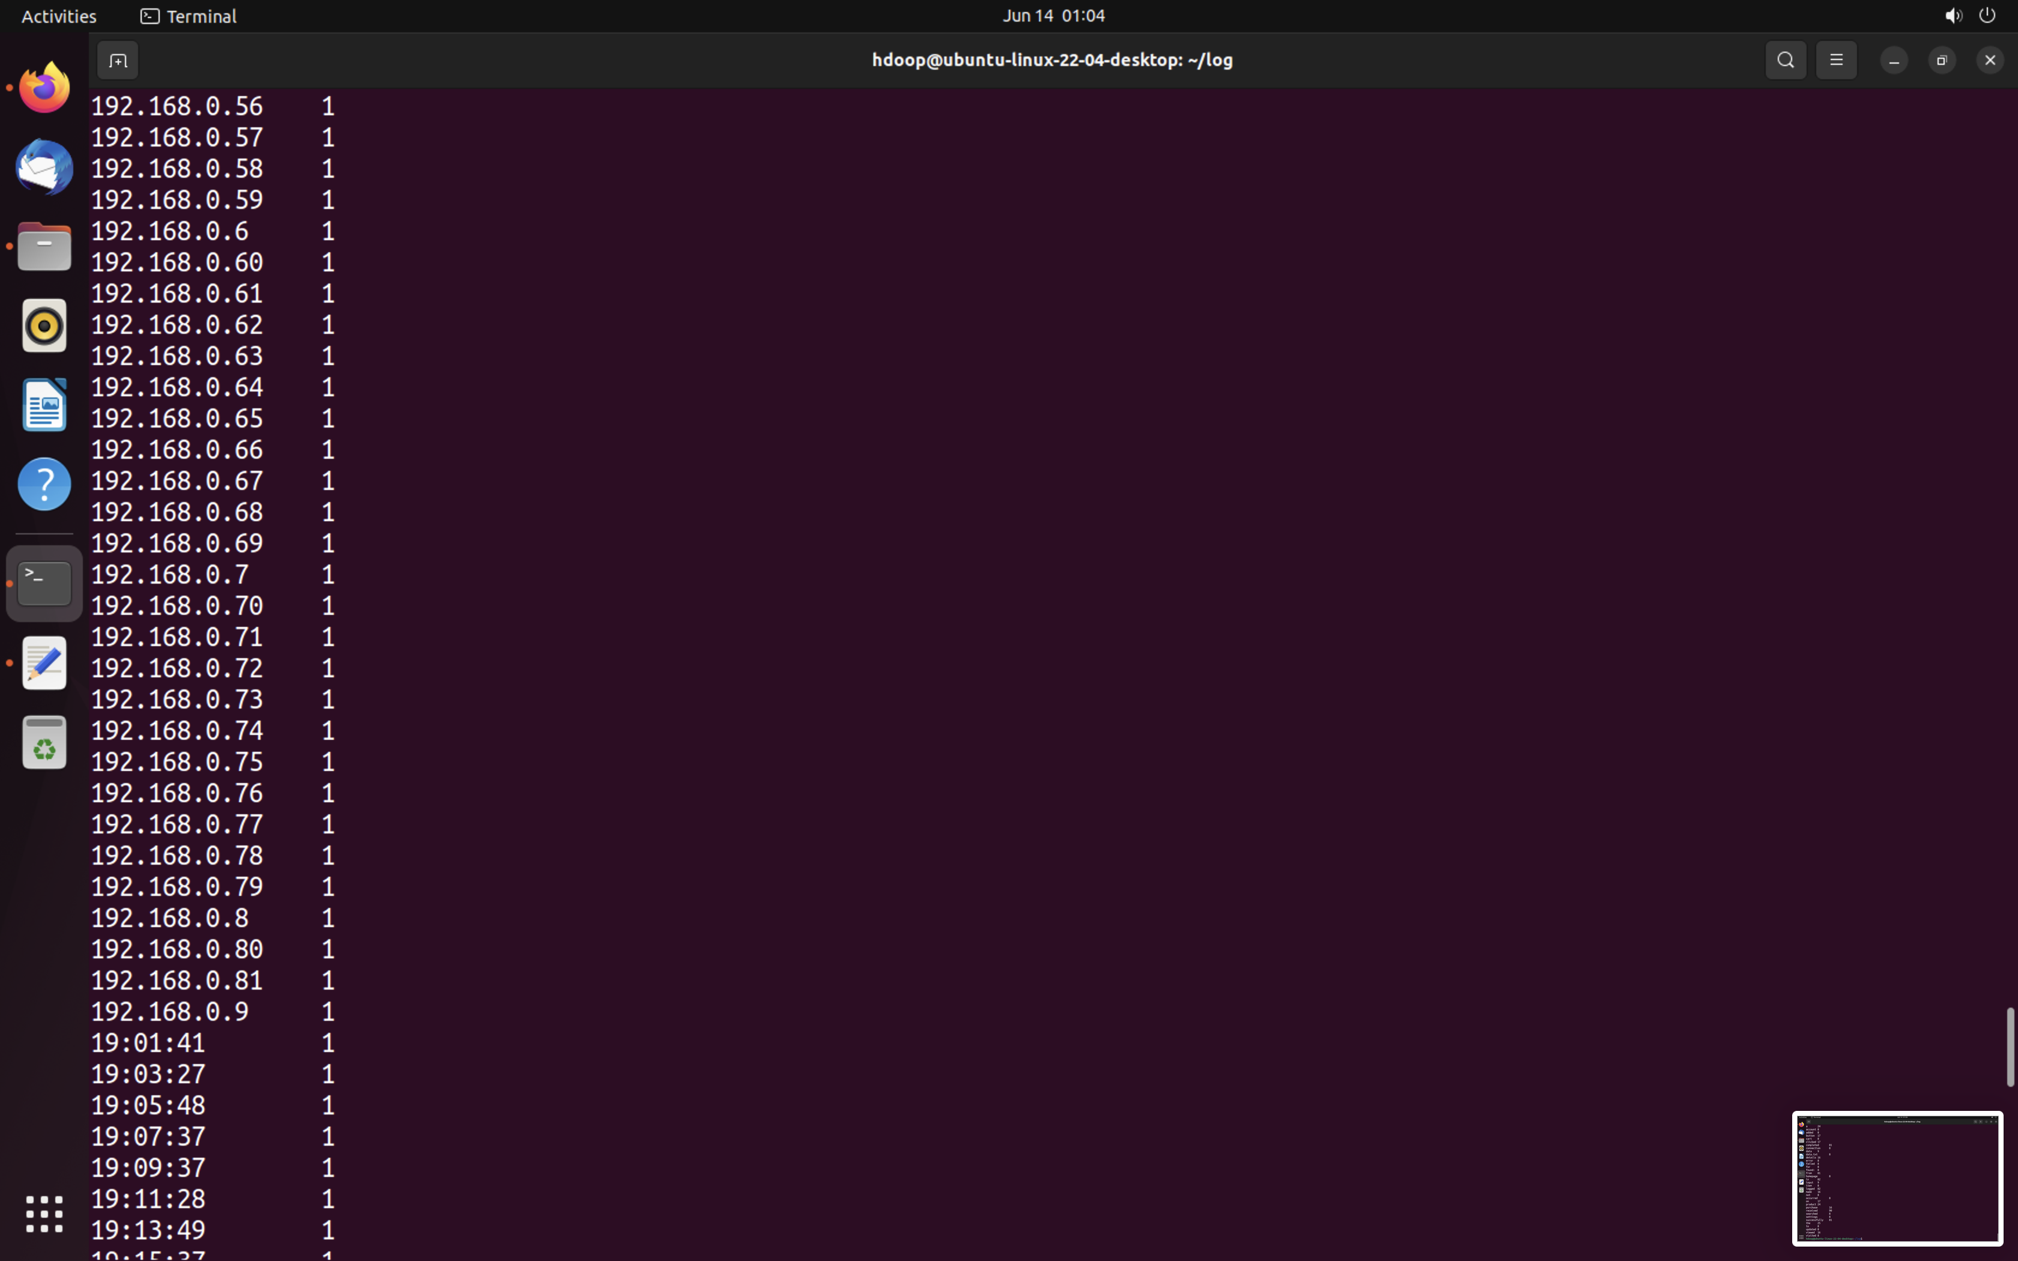
IP Result

Slide 21
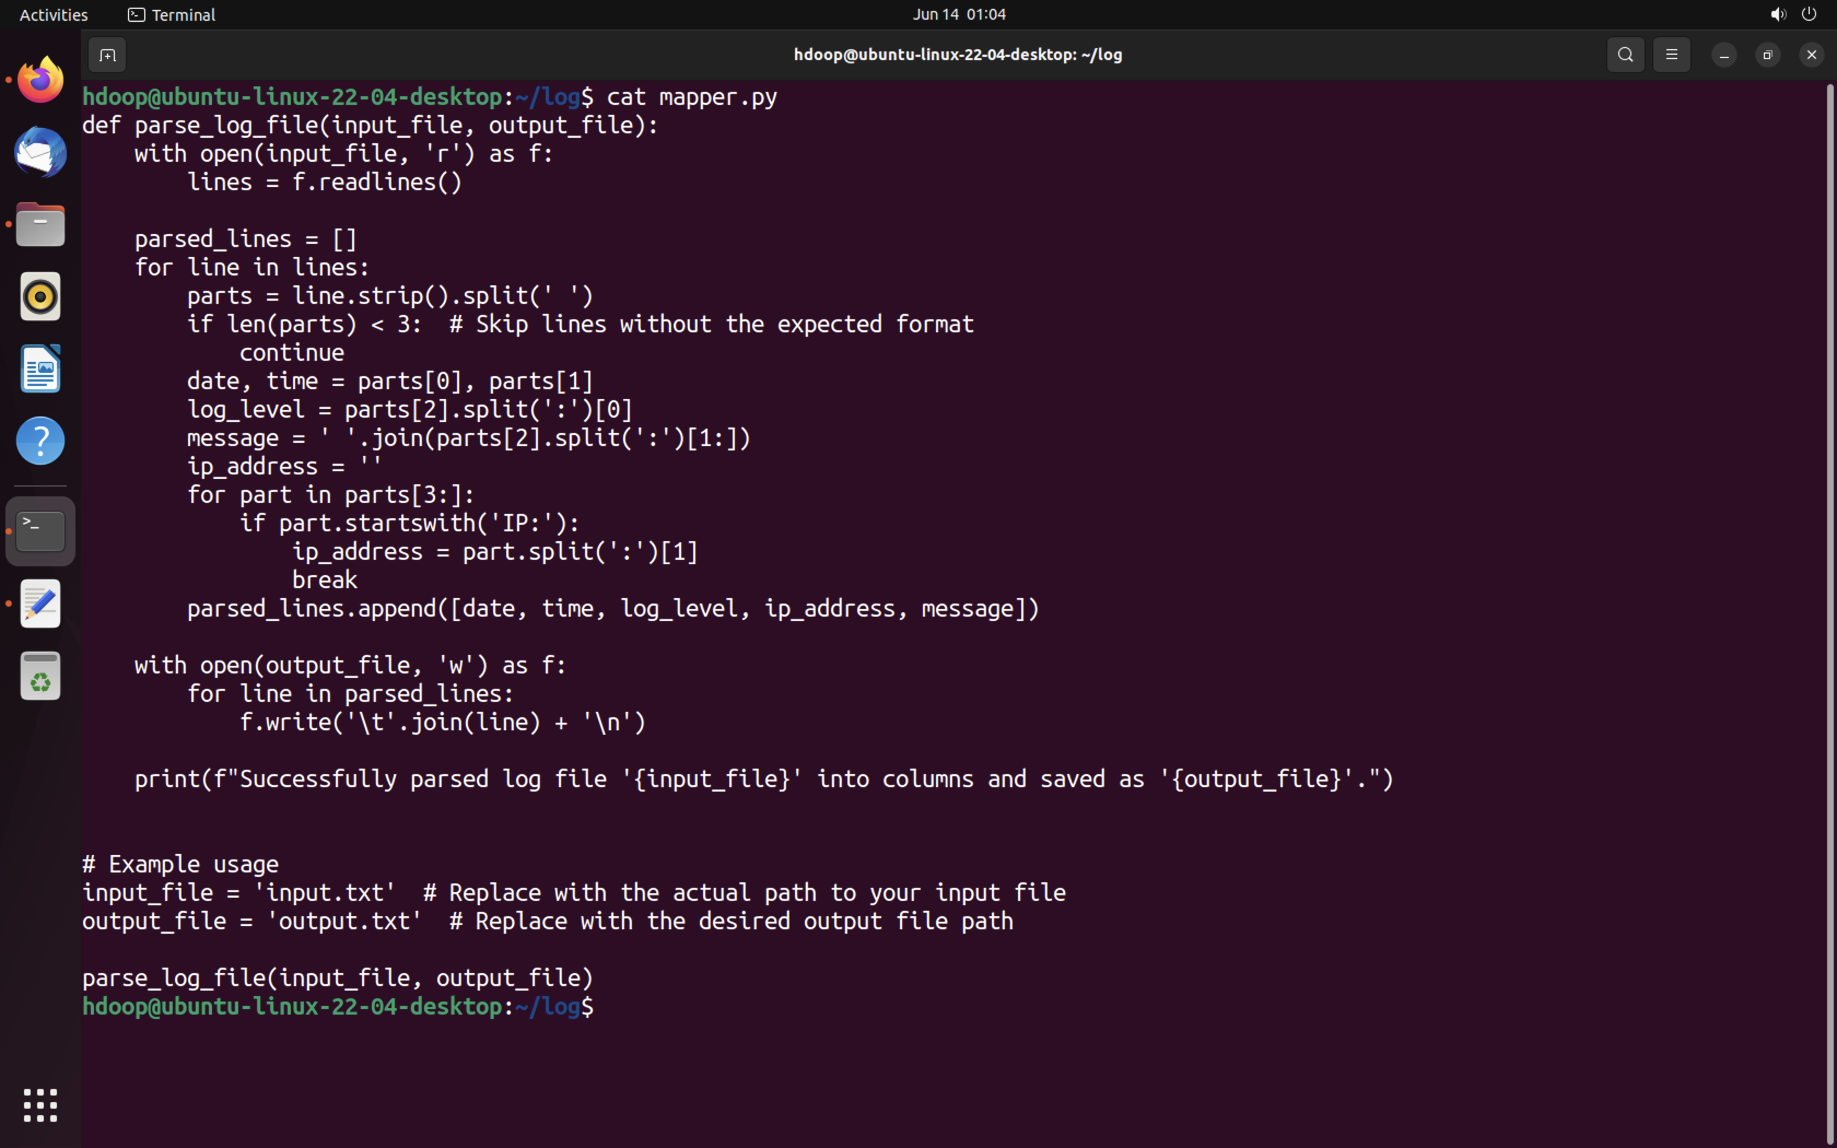
Let’s create a mapper.py file to create columns on our output file, you can also use hive

Slide 22
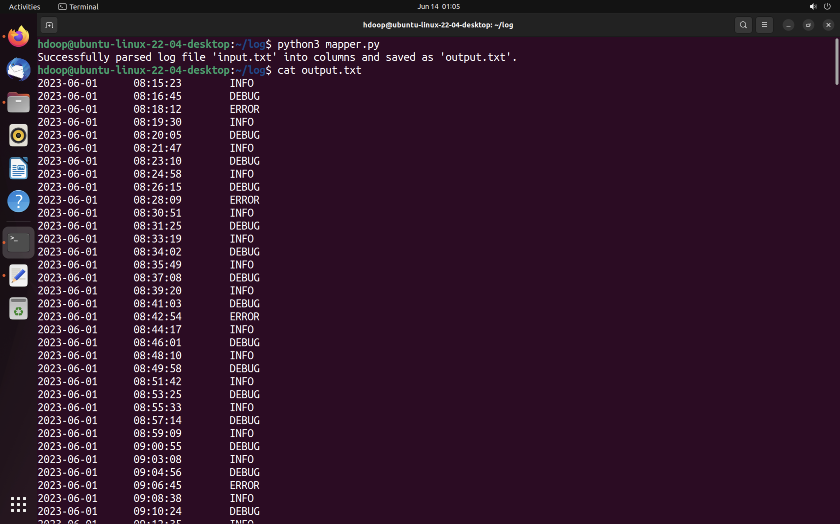
Result of mappr.py file

Slide 23
References:-
https://www.sciencedirect.com/science/article/pii/S1319157821003530
https://cio.economictimes.indiatimes.com/news/digital-security/hadoop-and-big-data-in-cybersecurity-models-for-businesses/90508073
https://www.sciencedirect.com/science/article/pii/S1877050919300067

